Slide 1
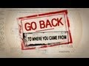
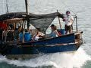
Go Back to Where you came from
A journey in reverse to that which refugees have taken to seek asylum
Texts and Human Experiences
How wonderful it is that nobody need wait a single moment before starting to improve the world
Anne Frank

Slide 2
A journey in reverse to that which refugees have taken to seek asylum
Go back to where you came from is a three-part multimodal documentary series that looks at issues covering refuges and asylum seekers. Six Australian participants, having opposing views on refugees and asylum seekers, agreed to embark on a reverse journey. Cinematic techniques are used to intensify the scenes which also impacts the viewers emotions and how they view the participants. The struggle with adversity is a human experience that is shown in Go Back to Where You Came From. Delving into global refugee crises can increase an awareness and understanding of the Global Refugee Crises.
Go Back To Where You Came From is one of the world’s most awarded television formats - winner of two Logie Awards, an AACTA Award, an International Emmy, and two Rose d’Or awards, as well as a UN Peace Award.
This resource explores refugee crises, journeys and issues around the world.
Classroom recommendations before using material in your classroom.
“Education is the most powerful weapon which you can use to change the world.” Nelson Mandela

Slide 3
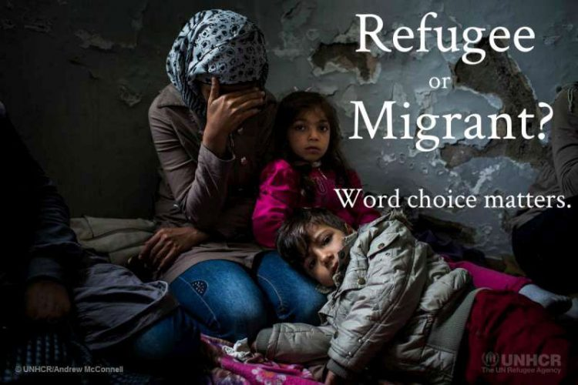


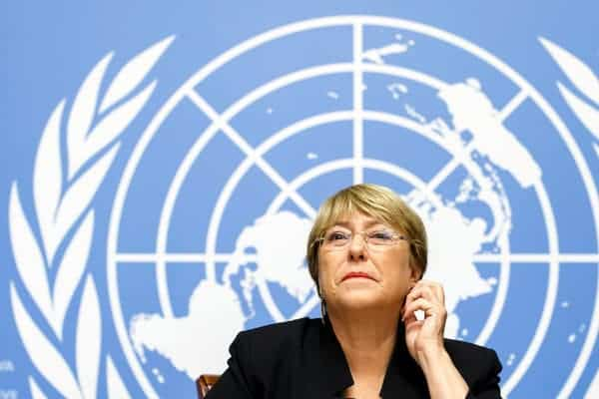
Who is a refugee? Who is an asylum seeker?
Who is a refugee?
‘Refugee’ is used commonly to refer to people who are forced to leave their homes for many reasons, including conflict and violence. Sometimes it is used to also refer to a person displaced due to a natural disaster.
Who is an asylum seeker?
The term ‘asylum seeker’ is often used interchangeably with ‘refugee’ but means something different under law. Asylum seekers are the people who have sought protection as a refugee, but whose claim for refugee status has not yet been assessed.
Who is an internally displaced person?
Internally displaced persons are people who are forced to flee their home but remain within their national borders. Internally displaced persons are not refugees under the Refugee Convention.
Ultimately, asylum seekers and refugees seek protection from persecution. How we meet and deal with them is a measure of our humanity. Martin Luther King, Jr. once said, “I refuse to accept the view that mankind is so tragically bound to the starless midnight of racism and war that the bright daybreak of peace and brotherhood can never become a reality… I believe that unarmed truth and unconditional love will have the final word.”(King, 1964)

Slide 4
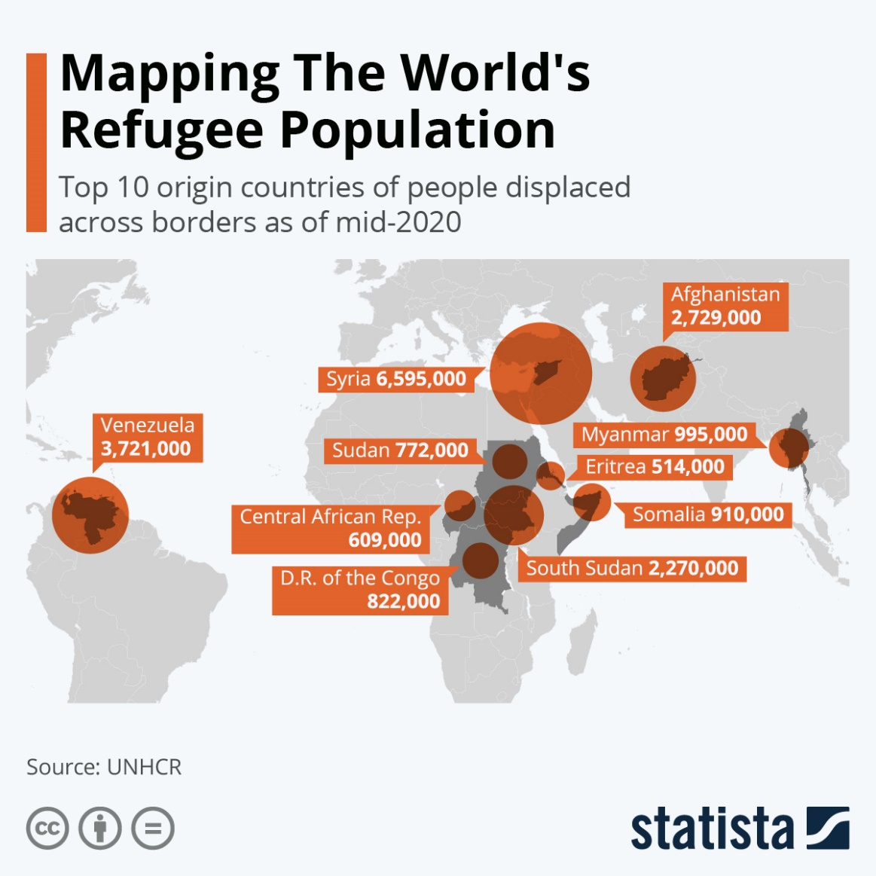
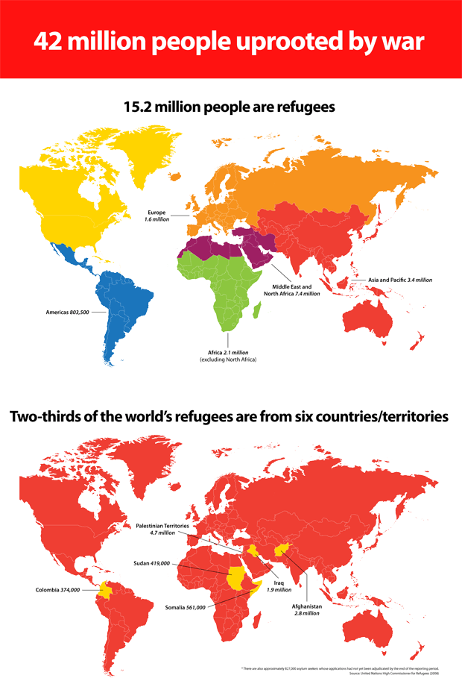
Go Back to Where you came from
At least 79.5 million people around the world have been forced to flee their homes. Among them are nearly 26 million refugees, around half of whom are under the age of 18.
imcreativeteacher™

Slide 5
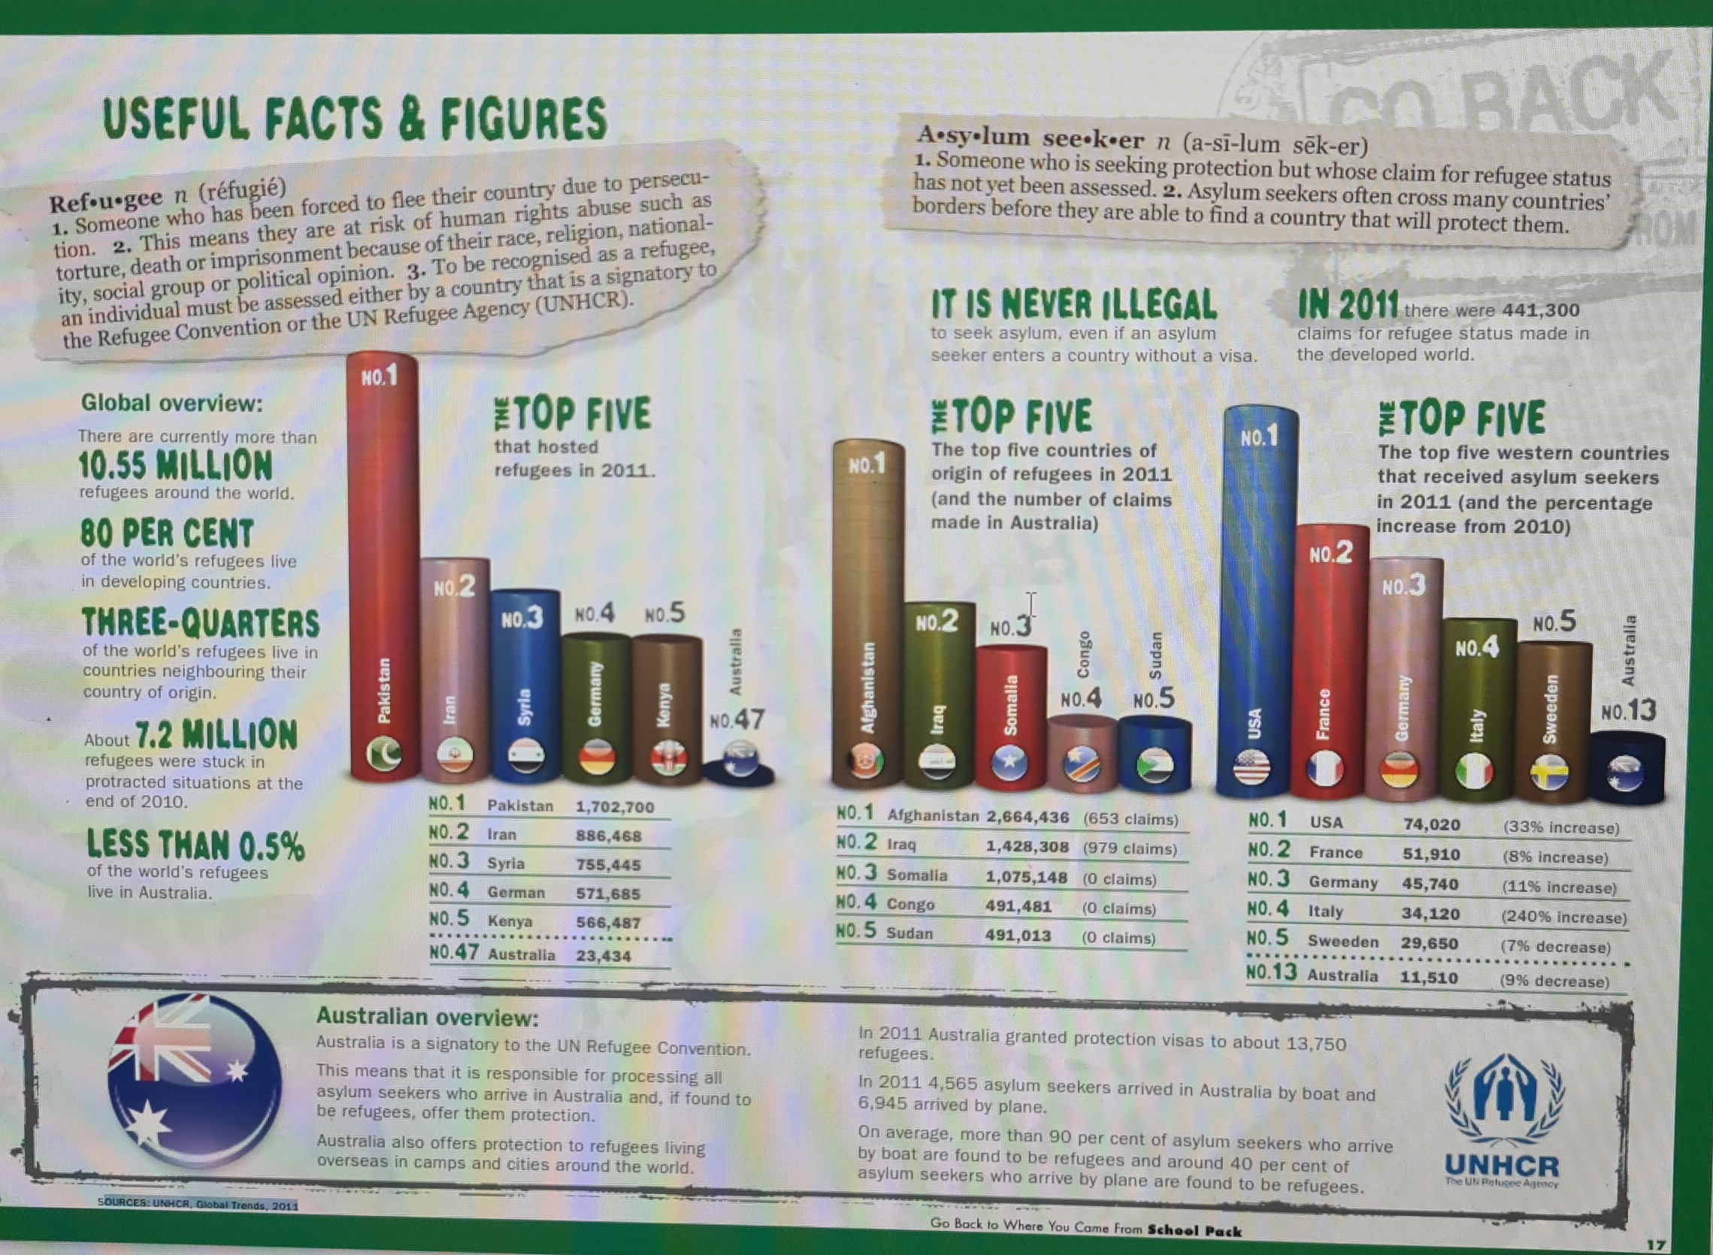

Slide 6
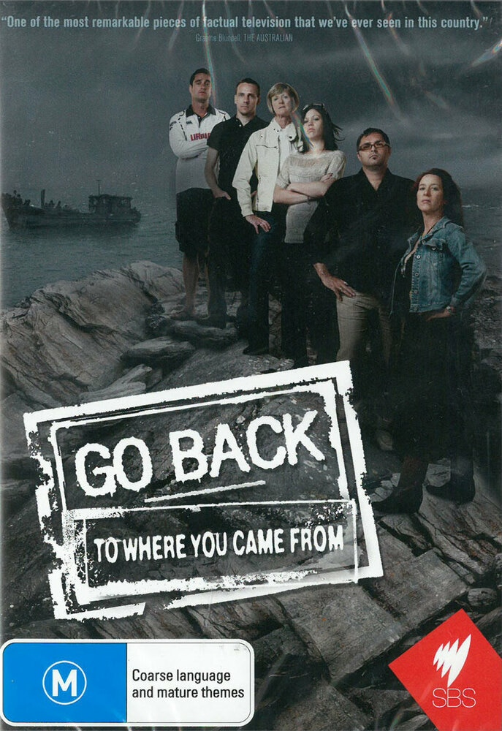
Go Back to Where You Came From: Series 1
This documentary series produced for SBS (Australia) informs about the complex international issue of the humanitarian care of refugees and asylum seekers.
Six ordinary Australians agree to challenge their preconceived notions about refugees and asylum seekers by embarking on a confronting 25-day journey.
Deprived of their wallets, phones and passports, they board a leaky refugee boat, are rescued mid-ocean, experience immigration raids in Malaysia, live in a Kenyan refugee camp and visit slums in Jordan before ultimately making it to the Democratic Republic of Congo and Iraq, protected by UN Peacekeepers and the US military.
For some of them it is their first time abroad and it is an epic journey and the most challenging experience of their lives.
This controversial series follows the participants over one month as they are confronted with the harsh realities of life as a refugee in their journey to some of the most dangerous and desperate regions of the world.
imcreativeteacher™

Slide 7
The Participants
GLENY RAE 39, grew up near Nyngan in western NSW. She lives in Newcastle where she works as a part-time schoolteacher and singer. She performs solo and in several bands that play around Australia. She thinks asylum seekers who arrive by boats are the most desperate of all and we should treat them humanely. She believes there should be a home-stay program to accommodate asylum seekers while their applications are processed. Notwithstanding her environmental concerns about overpopulation, Gleny thinks Australia should accept more refugees.
RODERICK SCHNEIDER, 29, is from Brisbane and works as a financial planner. He is a former president of the Queensland Young Liberal National Party and is running for the vice-presidency of the federal Young Liberals. His concern about asylum seekers arriving by boat is that we’re not properly dealing with issues that drive them here in the first place.
RAYE COLBEY, 63, lives opposite the Inverbrackie detention centre in the Adelaide Hills with her husband Peter and a couple of horses. She is angry about the money spent on the residents: ‘They get given everything. All they do is complain. We’re rolling out the red carpet with a glass of champagne at the end of it.’ She has no sympathy for the asylum seekers who died in December 2010 as a result of their boat hitting Christmas Island. ‘It served the bastards right,’ she says. Before retiring recently, Raye spent twenty-two years working with intellectually disabled children, whose plight she believes is being neglected while the refugees are cared for. ‘People don’t understand people with a disability. They fear them.
ADAM HARTUP, 26, is a Cronulla lifeguard who was on the beach on the day of the 2005 riots. Seeing people standing up for the country made him proud to be Australian, but when random Middle Eastern-looking people were being beaten up, it disturbed him. He has zero tolerance for asylum seekers arriving by boat. ‘Instead of harbouring them, we should just put them straight on a plane and send them back. He thinks Australia should help its own first. Adam has lived in Cronulla all his life and travelled through Asia and Europe. Last year he worked as a lifeguard in Greece during the Australian winter. Adam’s brother is a fireman who fought the Villawood detention centre fire in April 2011.
DARREN HASSAN, 42, is a father of two from Adelaide. He is staunchly against people coming to Australia by boat and subsequently ‘jumping the queue’. He runs an import/export business with his Taiwanese wife. As an aspiring politician he ran unsuccessfully at the last two federal elections.. Darren served in the Australian army for almost ten years as a radio operator. Darren’s ancestors were in the first group of Muslim families to arrive in Australia in the late 1800s as cameleers, but Darren is a practising, Christian. His nickname at school was ‘ref’ (as in refugee), which confused him. He feels his family integrated into Australian society but thinks many migrants and refugees haven’t integrated well. Darren doesn’t understand why asylum seekers travel through numerous countries before arriving here and suspects they ‘country shop’ for economic benefit.
RAQUEL MOORE, 21, lives in Sydney with her bikie boyfriend and their twelve show Staffordshire terriers. A self-confessed racist, Raquel is highly critical of refugees, especially Africans. She says she’ll never be friends with a refugee. She lives near Blacktown, describing it as a really ‘black town’. She believes Australia should not accept any refugees: ‘You don’t know what diseases they’re carrying,’ she says. ‘We need Pauline Hanson. She’s really strong about asylum seekers not coming to Australia.’ Raquel left home at thirteen, moving around between relatives, before moving in with her partner at sixteen. She is currently unemployed.
imcreativeteacher™

Slide 8
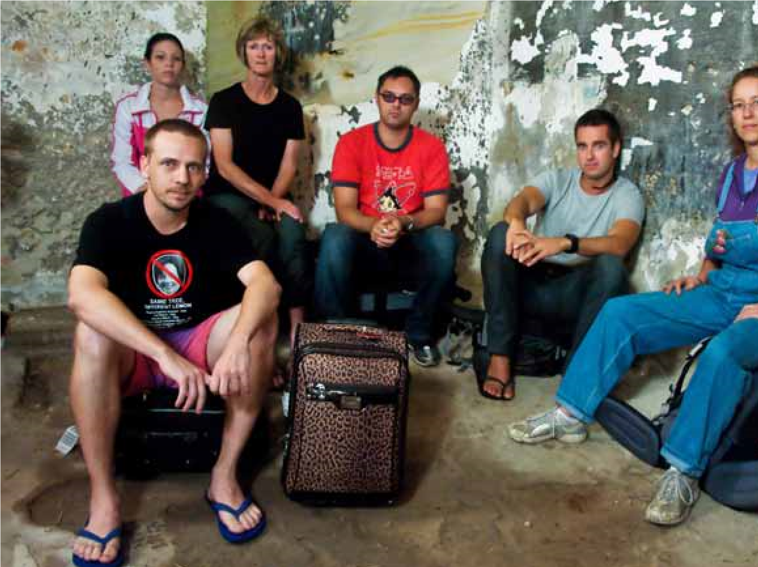
Raquel Moore
Raye Colbey
Darren Hassan
Adam Hartup
Roderick Schneider
Glenny Raye

Slide 9

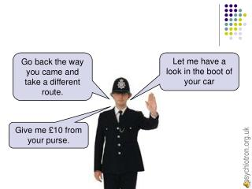
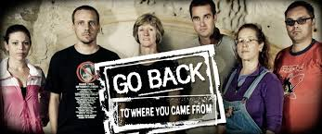
Think and Respond –
In groups answer the following questions
What does it mean to be a refugee?
Who are asylum seekers?
What do most nationals think about refugees and asylum seekers? Are there differing views on the topic?
What do you know about refugees and asylum Seekers?
View Go Back to where you came from (SO1E01) and make notes.
Has you view/understanding changed?
‘I was a Stranger and you made me welcome’
Matthew 24:35
imcreativeteacher™

Slide 10
Go Back to Where you Can From
Fill out this worksheet after your first viewing of the text. Your task is to ‘understand human experiences’ of the participants and establish their personal opinions in relation to asylum seekers and refugees.
Name of Participant | Who they are – provide a brief biography | What was their original position – their perspective at the beginning of the journey | Final position – what ‘human experiences’ lead to a change in their original stance
Gleny Rae – singer from Newcastle
Adam Hartup, Cronulla lifeguard
Raquel Moore, unemployed from western Sydney

Slide 11
Go Back to Where you Can From
Fill out this worksheet after your first viewing of the text. Your task is to ‘understand human experiences’ of the participants and establish their personal opinions in relation to asylum seekers and refugees.
Name of Participant | Who they are – provide a brief biography | What was their original position – their perspective at the beginning of the journey | Final position – what ‘human experiences’ lead to a change in their original stance
Darren Hassan, businessman from Adelaide
Raye Colbey, retired social worker from Inverbrackie, SA
Roderick Schneider, Financial planner from Brisbane

Slide 12
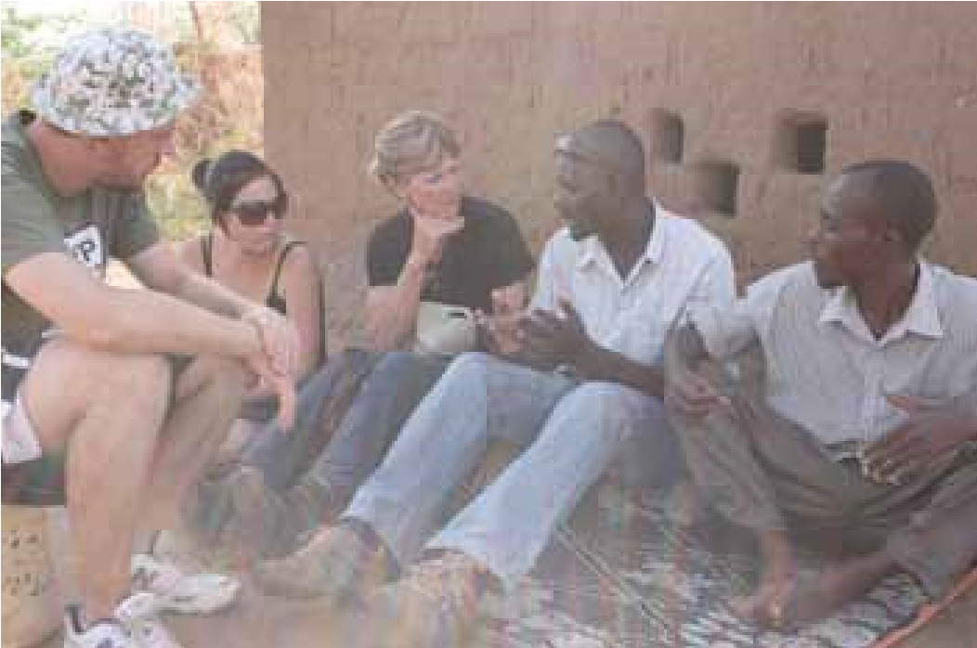
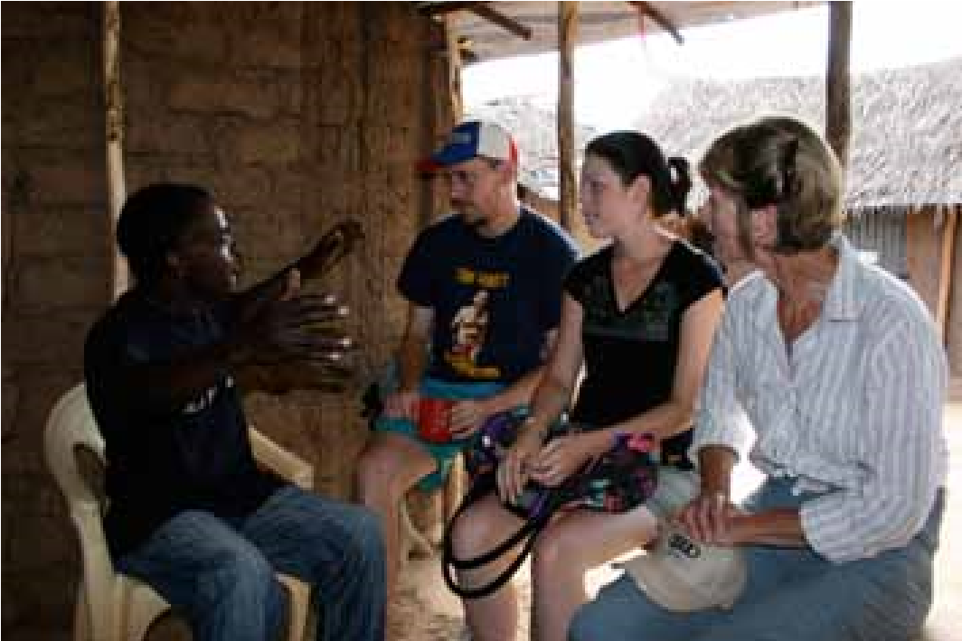
Episode 1
Episode One the documentary opens with a montage of news footage and comments.
What information about the refugee issue does the footage tell you?
Why do you think the producers have chosen to open the documentary in this?
Next we meet the participants and learn their individual views.
Where do they first meet?
Why do you think location was chosen?
The participants break into two (2) groups
Raquel, Raye and Roderick visit newly settled refugees in New South Wales.
What is the background story of this family?
How did they arrive in Australia
Adam, Darren and Gleny travel to Sydney to the home of another refugee family who arrived as illegal boat people.
Who are the boat people and where do they come from?
Why is the family living in Australia without their families?

Slide 13
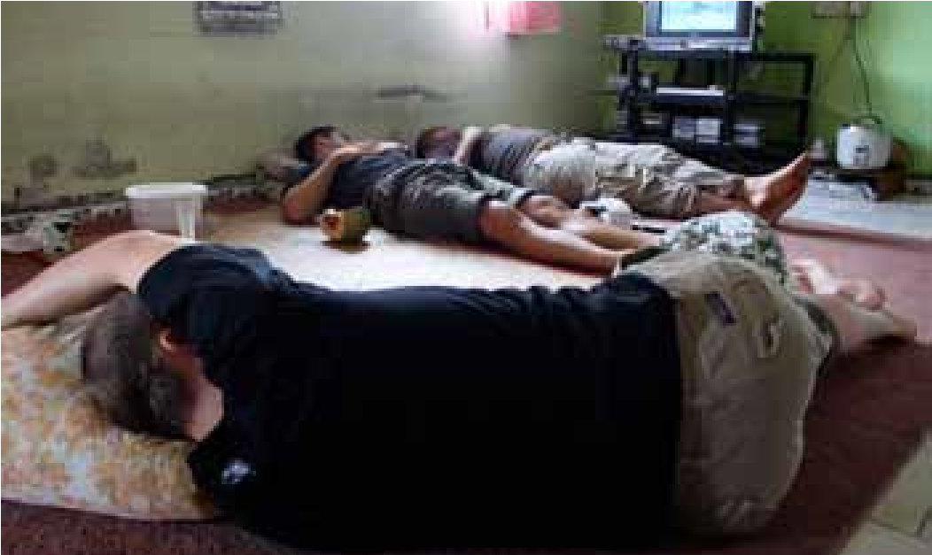
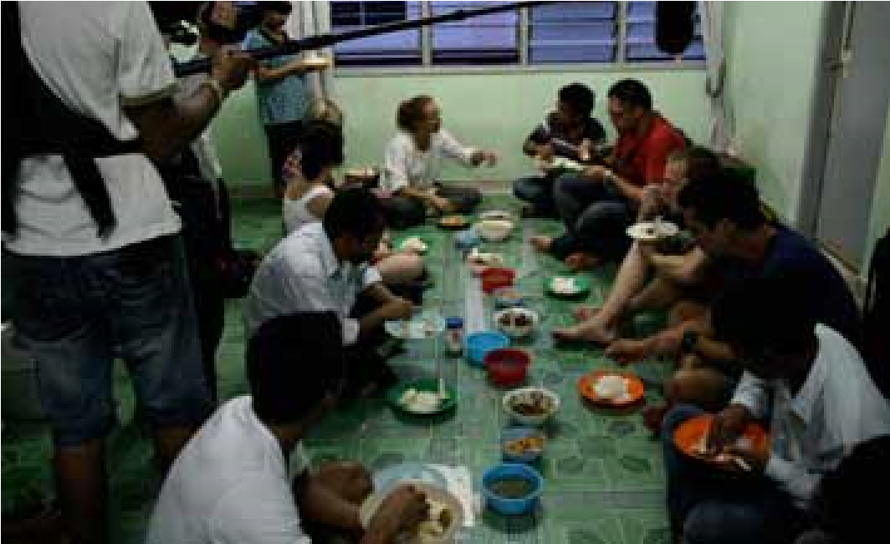
Episode 2
Episode Two opens with the participants now in Malaysia. It is night. They have been move through a settlement where illegal refugees are living.
What are some of the reasons why these people have found their way to this settlement?
What medical facilities are available here?
These settlements are commonly located on outskirts of large towns. There is no United Nations camps (UNHCR) in Malaysia.
What is the availability of water here?
Why do you this think location was chosen?
Next the participants arrive in Kenya, East Africa. They have no security.
What is making the Australians anxious?
What information do they give when ‘checking in’?
Arriving at Kakuma Camp the Australians are confronted with some harsh realities of life.
Describe the housing sleeping conditions allocated to the Australians.
What foods are available in the store in Kakuma Camp?
How many nationalities are residing in Kakuma camp? Name 5 countries.

Slide 14
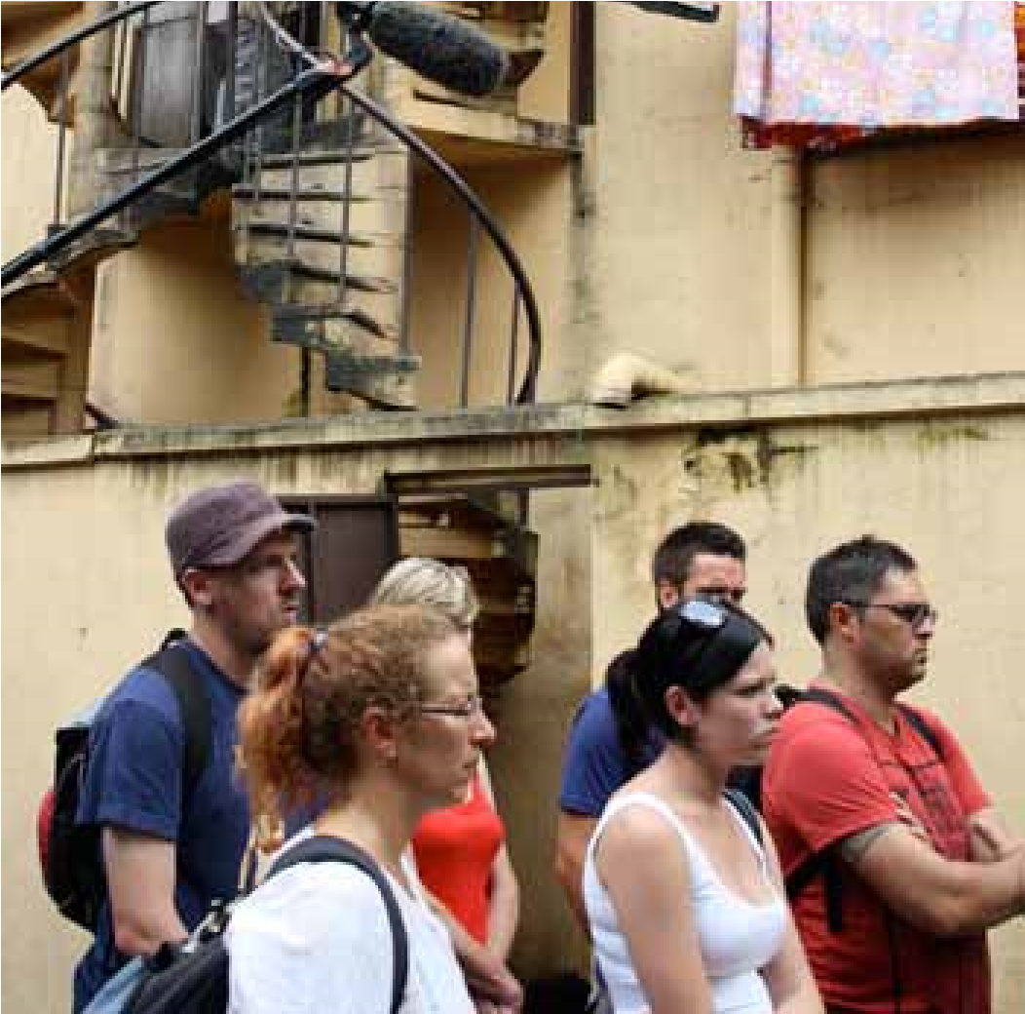
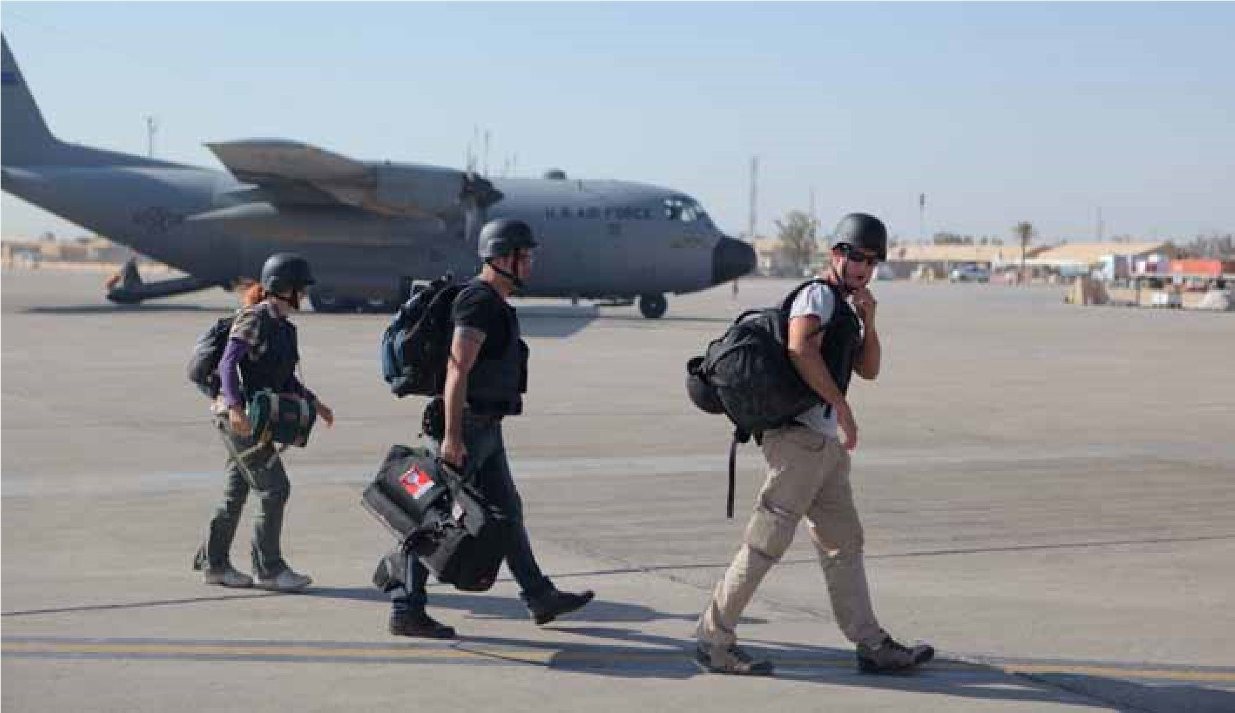
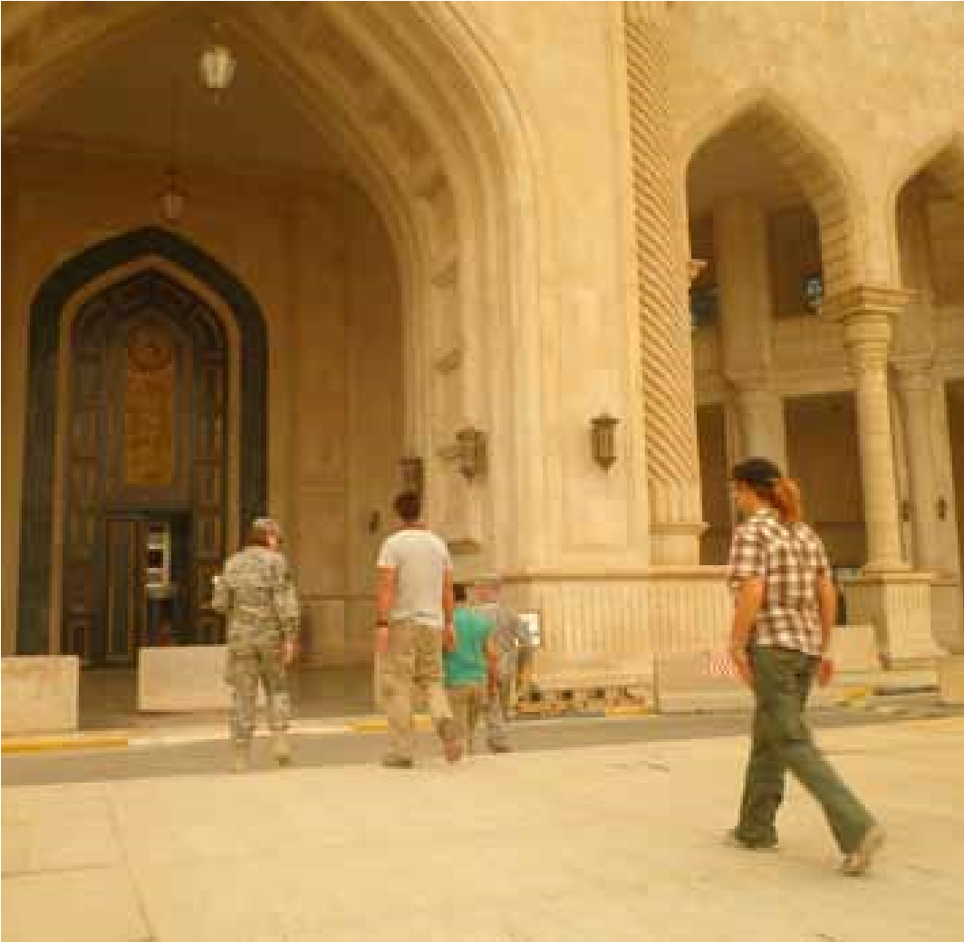
Episode 3
Episode Three the participants are still in Kakuma Camp, with relative security.
What are the main religions and population of Kakuma Camp?
Describe how food is distributed?
In Amman, capital city of Jordan, Doctors Without Borders operates free those who cannot get medical help back in their homeland.
Describe the charity work of Doctors Without Borders?
Explain how their support helps restore hope for many refugees?
Why was the farewell from Kakuma an emotional time for the Australians?
In Jordan, the participants learn that the government welcomes Iraqis who have no legal status, but they cannot work or have access to medical treatment.
How do the Iraqis support themselves if they cannot work?
Under the protection of the American Army in Baghdad, Adam, Darren and Gleny move from the Green Zone into the Red Zone.
Explain the difference between the Green Zone and the Red Zone?
How does the Baghdad experience help the Australians understand the boat people they met in Sydney?

Slide 15
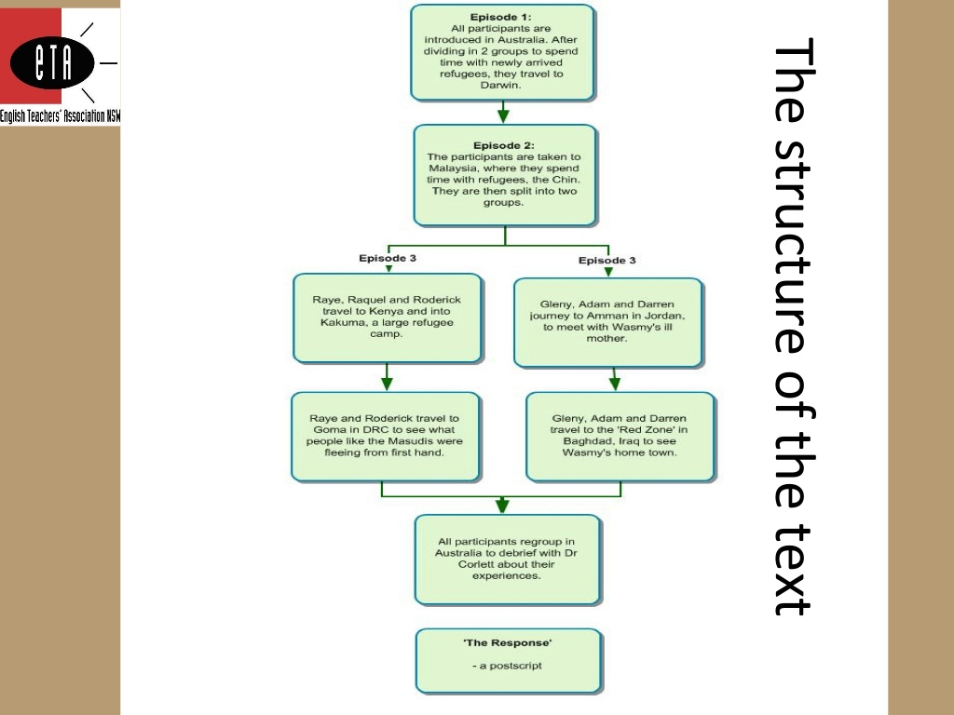
Go Back to where you came from – recap episodes

Slide 16
Go Back to Where You Came From
Use this table to identify and explain various documentary techniques used in Go Back to Where You Came From
Documentary Technique Table
Technique | Example | Effect
Archival Footage
Handheld cameras
Voiceover narration
Statistics and Facts
Interviews
Real people

Slide 17
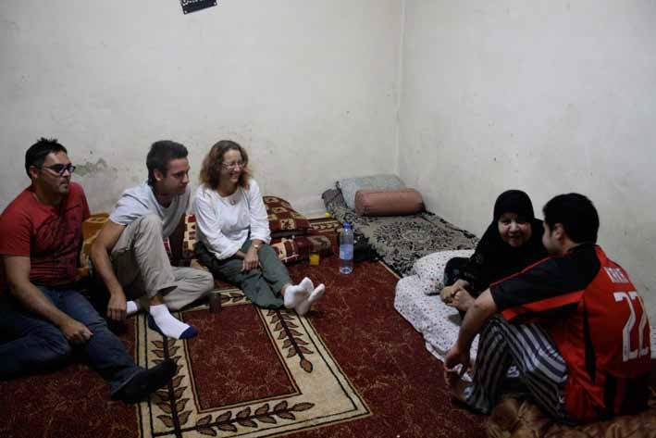
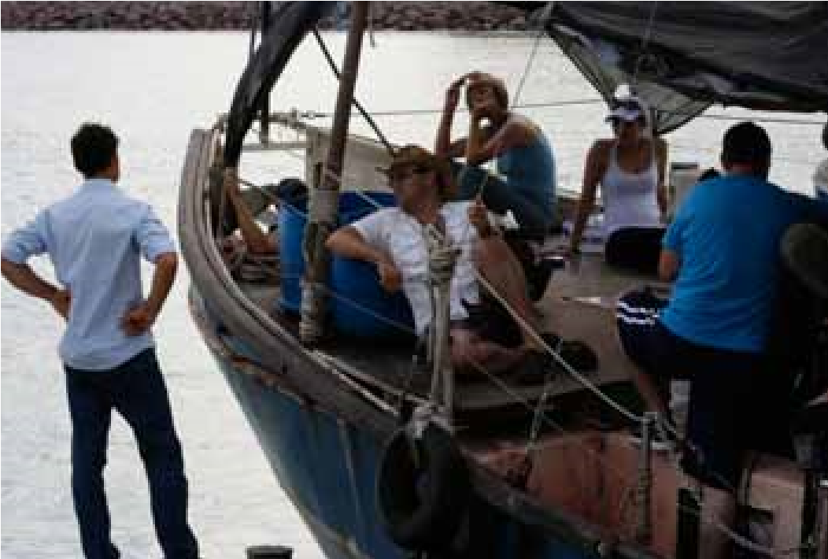
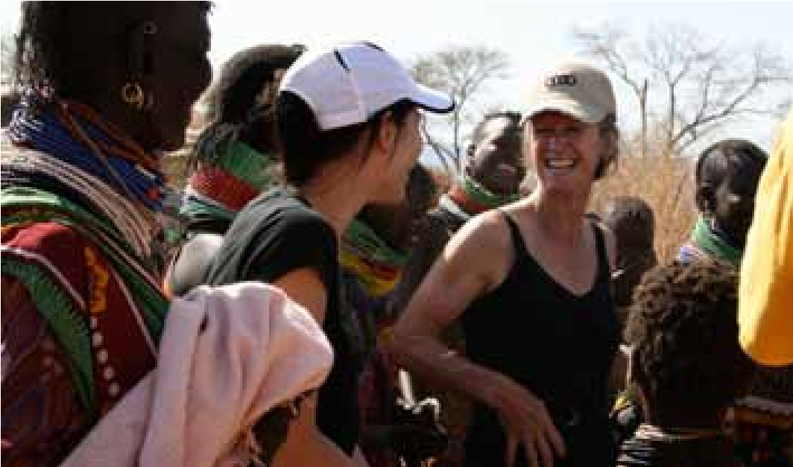
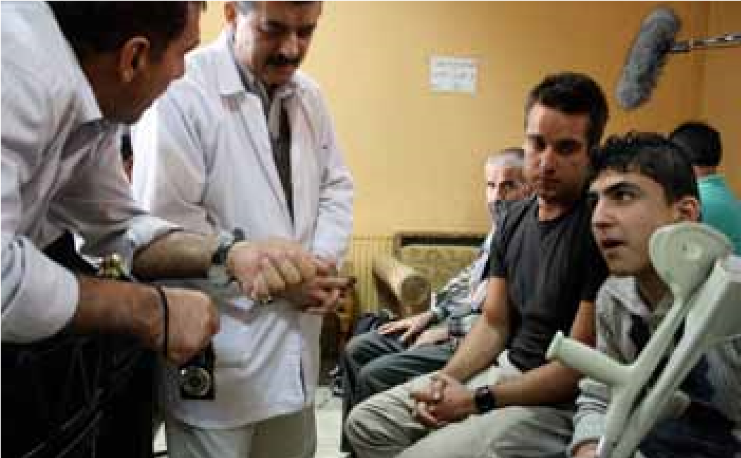
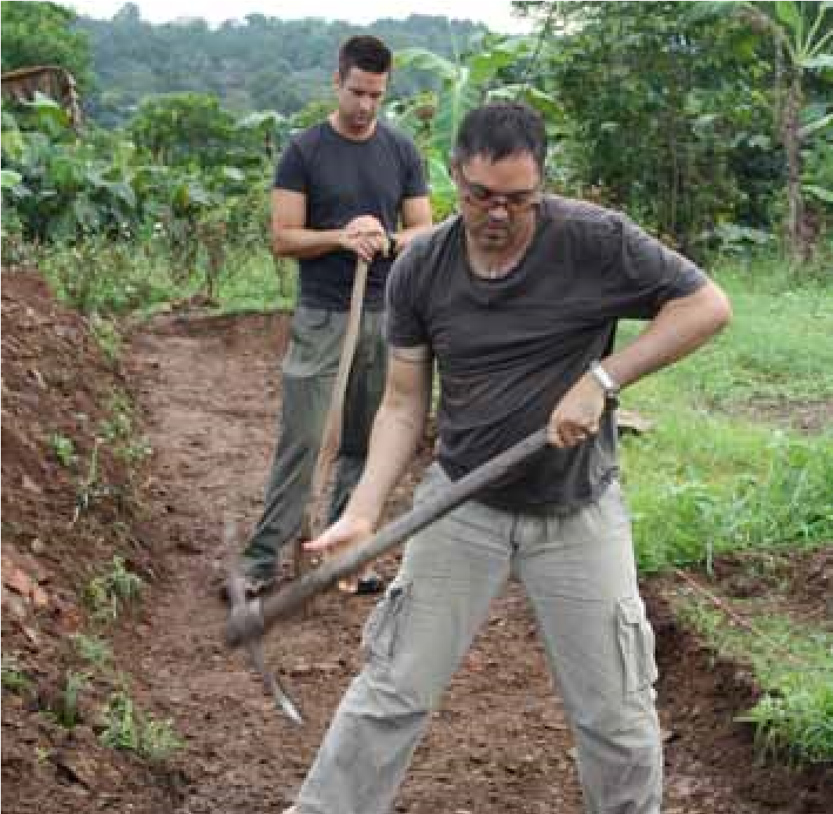
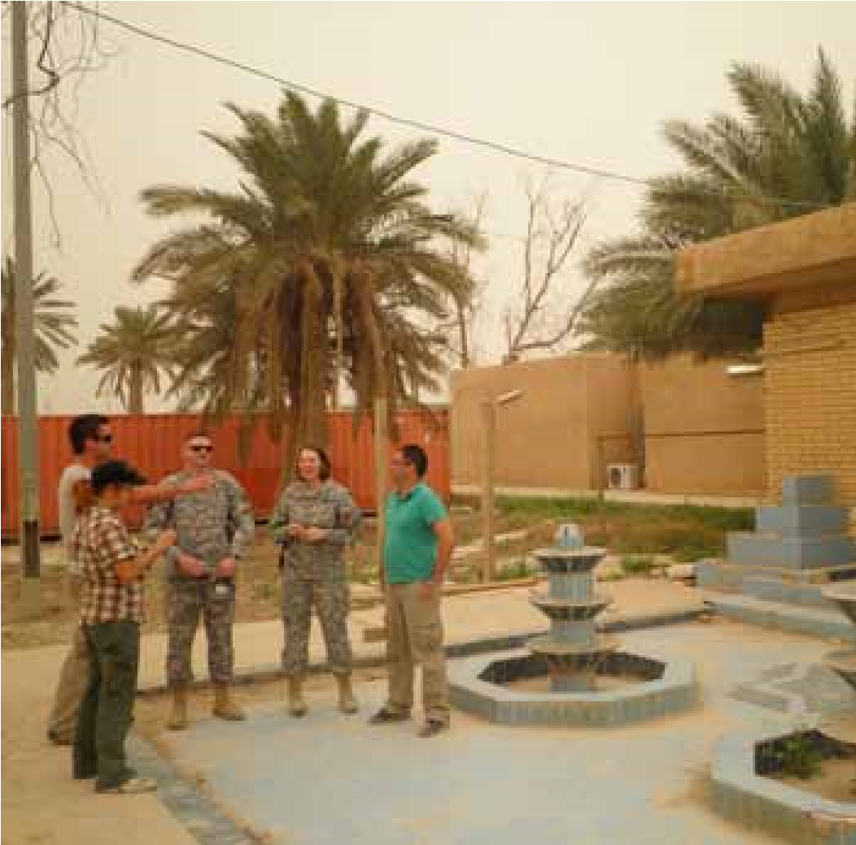

Slide 18
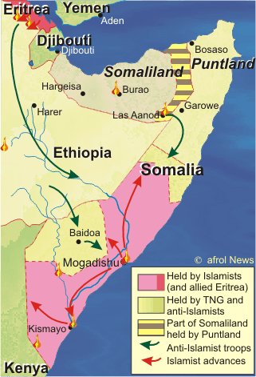
Important Terminology
Research these words/terms on the internet.
Write their definitions for future reference.
Illegal migrants
People smugglers
United Nations
Police raids
Slums/Settlement
Human settlement
Food distribution
Doctors without Borders
Civilians
Political turmoil
Combat operations
Displaced person
imcreativeteacher™

Slide 19

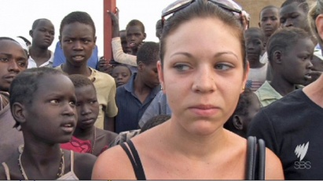
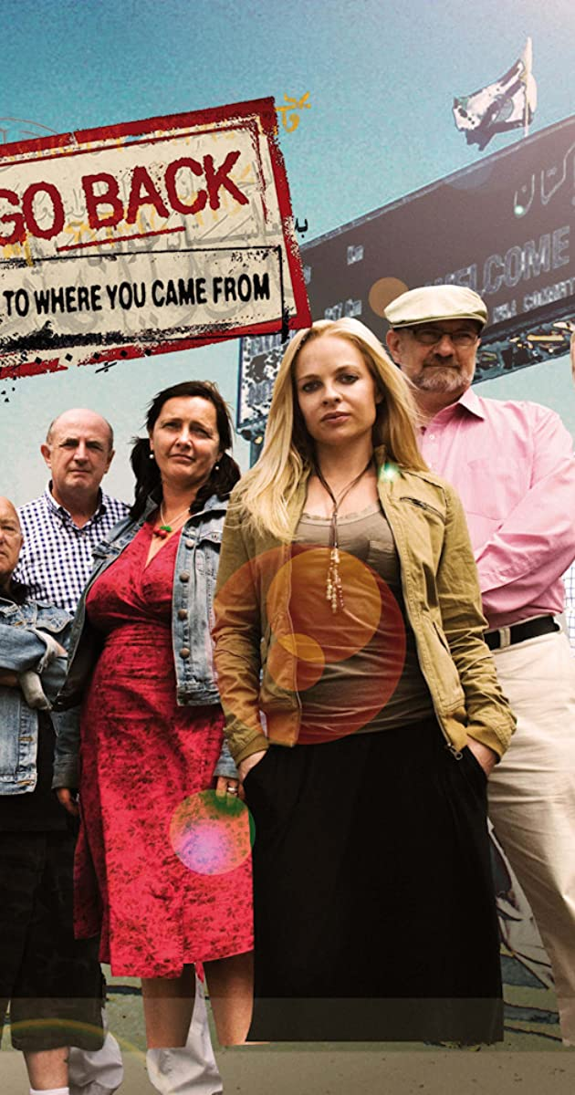
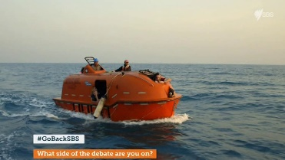
Go Back and Review – Participants
Reflection
How have the participants changed since their experience?
Which participants probably changed the most and explain briefly?
Did any of the participants not change their views? Explain
Which countries do asylum seekers, and refugees leave in order to be offered resettlement?
Why do people leave their homeland in order to seek asylum? List 3 reasons
As a result of your ‘experiences’ of the asylum seeker and refugee make a list your at least 10 things you have understood about ‘human experiences’. (This will become notes for your essay question).
imcreativeteacher™

Slide 20
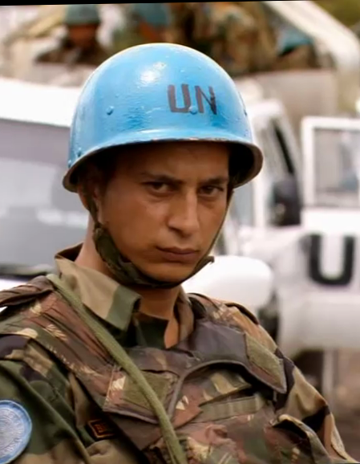
Go Back to Where You Came From - Analysis
Understanding graphics and narration
Graphics are images, pictures, maps, graphs, symbols and visual prompts which engage and connect with the audience.
The effects of using graphics, visual prompts and evidence enables the audience to understanding and interpret events.
They help clarify information and situations e.g.
Graphs
Narration – leads the audience through the information/facts/topics of the documentary as a way of offering insight for persuasion.
One of the more memorable examples of mise en scene from Go Back to Where You Came From.
Note the use of shallow focus, framing, gaze, and slight high angle to keep the sky out of frame (hence dampening any chance of symbolic 'openness' or optimism)
imcreativeteacher™

Slide 21
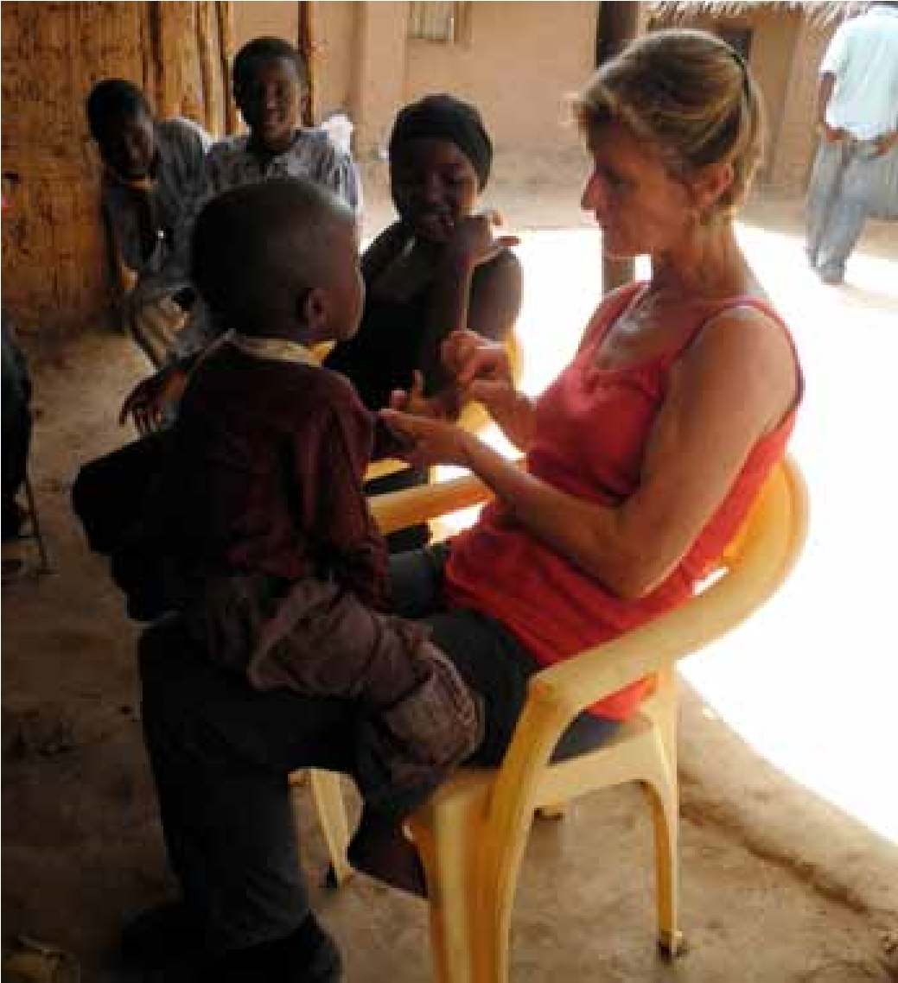
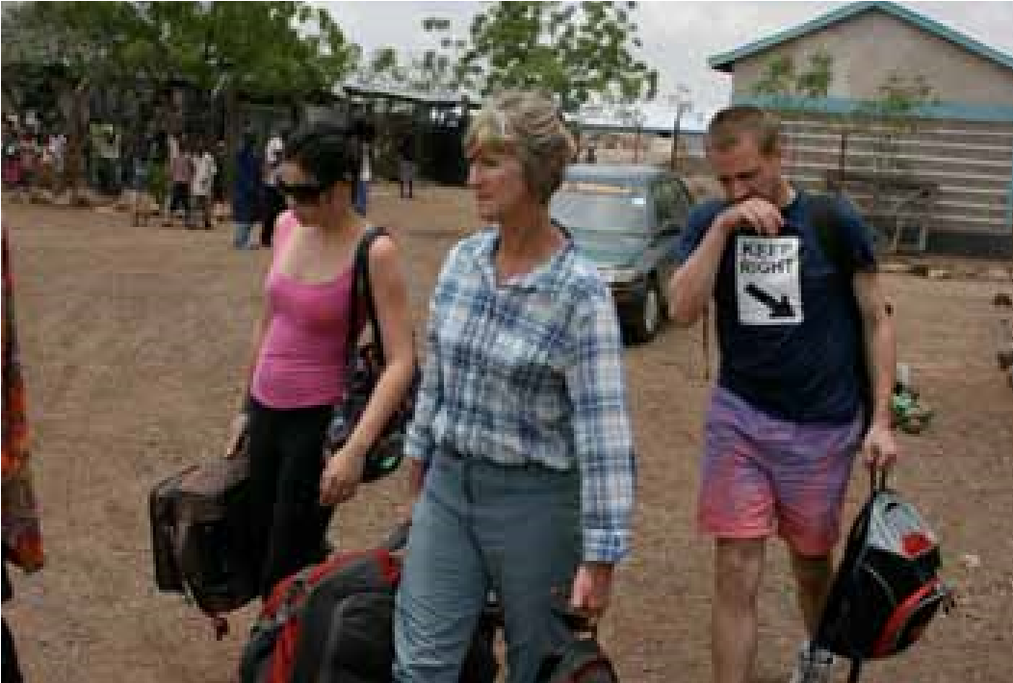
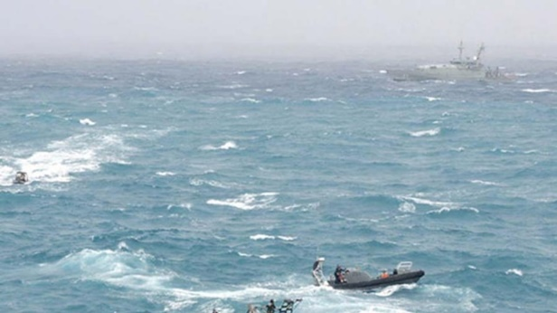
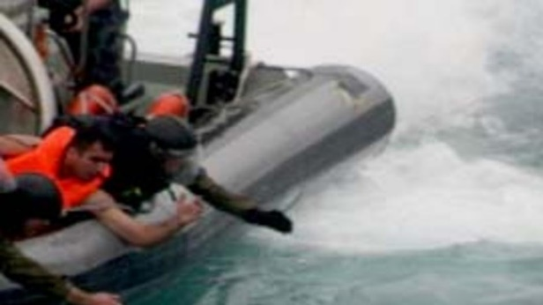
Go Back to Where You Came From Analysis
UNDERSTANDING ARCHIVE FOOTAGE
GO BACK WHERE YOU CAME FROM - DOCUMENTARIES TECHNIQUES
The archive or archives are a collection of documents and records that contain historical information. Archival film footage shows true and real images that have been recorded.
The footage has not been “created or “staged”.
By using ‘archival footage’ adds history and factual ‘footage’ to an argument or point of view. This adds credibility to the documentary.
The documentary shows clips of archival footage from various news reports in the opening montage of episode 1 as well as footage of the refugee boat wrecked of Christmas Island.

Slide 22

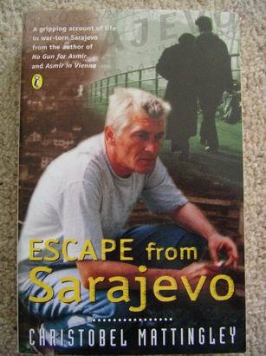


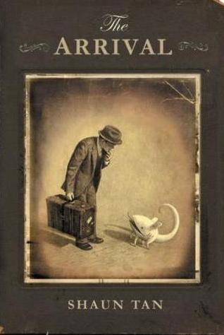
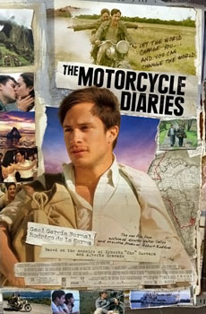
Compare and Contrast – Human Experiences
Explore different versions and accounts of events to evaluate and understand human motivations and behaviours.
The following are some suggested texts worthy of investigation
Text | Author
Mahtab’s Story | Libby Gleeson
Boy Overboard | Morris Gleitzman
The Arrival | Shaun Tan
Escape from Sarajevo | Christobel Mattingley
The China Coin | Allan Baillie
The Motorcycle Diaries | Ernesto Guevara
I am Malala | Malala Yousafzai & Christina Lamb

Slide 23
Ways which the concept of human experience is represented in and through texts
Go Back to Where you came from
IN Texts
The texts sets up a social experiment
The text offers perspectives through the narration
The text presents the participants confronting situations
The text visually shares lives of different people, in different places with different experiences
The text encourages emotion by exploiting sound and sight
THROUGH Texts
Discourse about human experiences in society are reinforced or challenged THROUGH the text
Sociology sees ‘human experiences’ as coming from interaction, so this interaction takes place IN the text and is conveyed THROUGH the text.
Television is the medium (the ‘THROUGH’) for audiences to encounter and evaluate what it means to be human.
The text invites the audience into the text to share THROUGH social media.

Slide 24
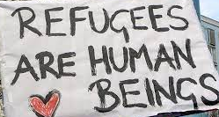
Human Experiences – Refugees & Asylum Seekers
Future Possibilities
New Worlds
New Ideas
New experiences
Renewed perceptions of being a human
New Understandings
New Values

Slide 25
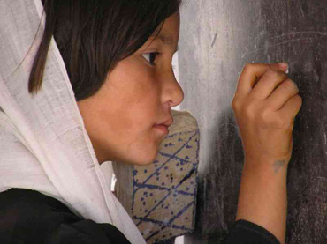
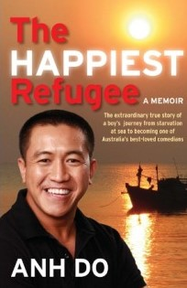
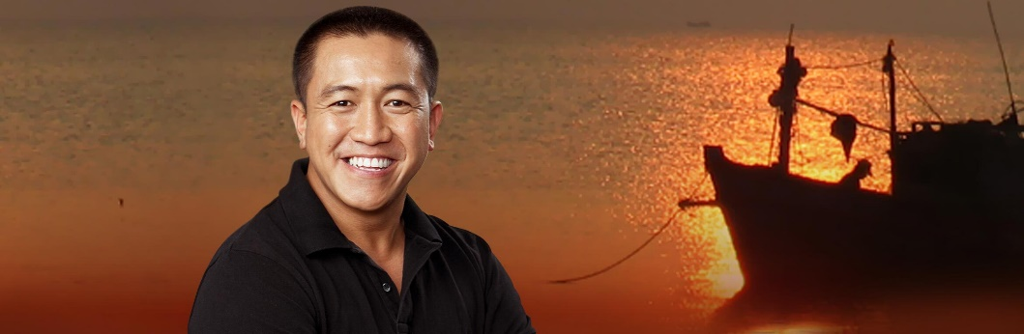
Go Back to Where You Came From
Suggested Activities – understanding ‘human experiences’.
To what extent does the media (such as the documentary – Go Back to Where you Came From) shape our identity and opinions? Examine the ways that globalisation and travel changes our beliefs?
To what extent are refugee camps considered a ‘safe haven’? Explore the experiences of men, women and children from refugee camps globally. (Choose at least two different countries to compare.)
Examine the variations in access to resources (food, water, health, education) globally.
Investigate the lives of refugees who have been resettled in new countries. Examine the strengths, skills and knowledge that persons from a refugee background bring to their respective communities.
Suggested investigations – Global Worlds – Seeking refuge – the Journey
Anh Do – The Happiest Refugee

Slide 26
Go Back to Where You Came From
Writing a Band 6 (A+) Essay
Before you begin you need to understand the format of an exemplar essay.
How is the introduction structured.
Have you addressed the question and raised a thesis statement (answer the question) and an argument
Next you should try to present and discuss something closely relating to points of reasoning and evidence.
Your essay should include relevant examples, supporting evidence and information from your prescribed text and related texts.
Does it have a strong conclusion.
Example Question –
Texts “hold as ‘twere the mirror up to nature; to show vieture her feature, scorn her own image, and the very age and body of the time his form and pressure”. Hamlet (3.2.17-24)
To what extent does this statement reflect representations of individual and collective human experiences in your prescribed text and ONE other related text?

Slide 27
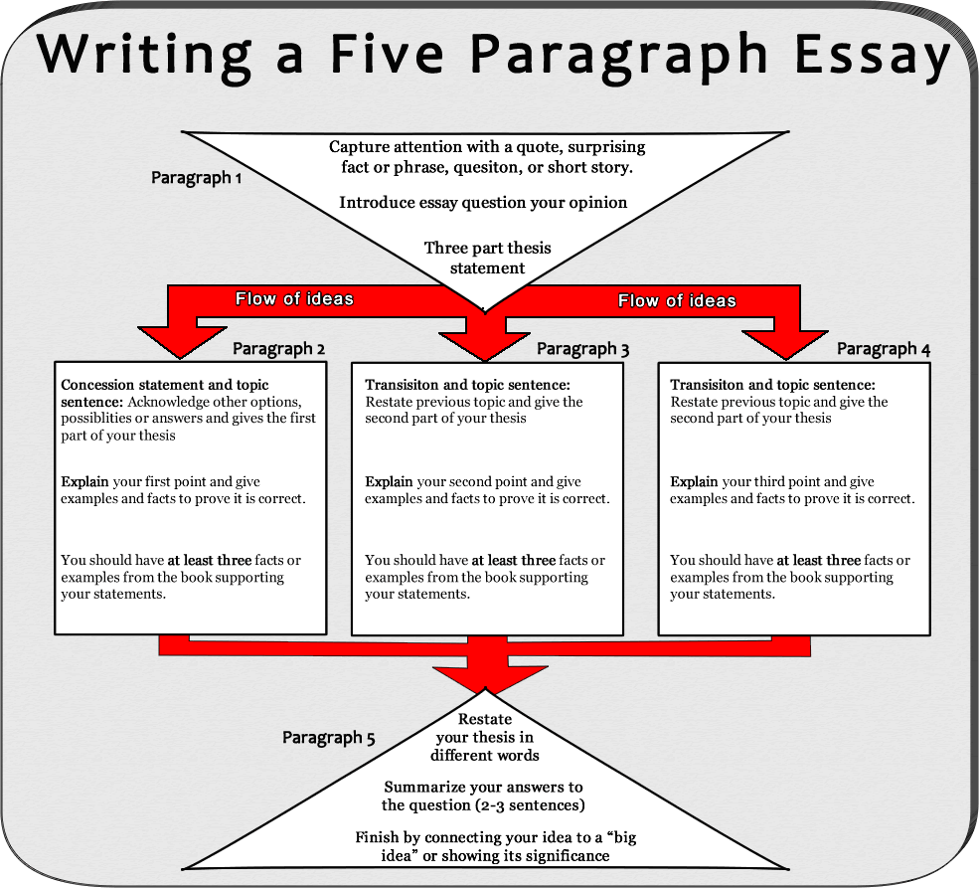

Slide 28
Go Back to Where You Came From
Sample Band 6 (A+) Essay Example Question –
Texts “hold as ‘twere the mirror up to nature; to show virture her feature, scorn her own image, and the very age and body of the time his form and pressure”. Hamlet (3.2.17-24)
To what extent does this statement reflect representations of individual and collective human experiences in your prescribed text and ONE other related text?
Sample Introduction
The figurative notion of texts mirroring nature implies that tests are an accurate reflection of human characteristics and relationships and this is represented in the documentary series by Ivan O’Mahoney, Go Back to Where You Came From (2011); and the emotive Mahtab’s Story by Libby Gleeson (2008). These two texts represent both individual and collective human experiences by exploring the process of change, which, in their respective contexts of government legislation, danger, and feelings of isolation results in ‘us against them’ when trying to keep hope alive’. Both texts highlight individual experiences of identity and belonging and uncover desirable aspects of our humanity, as much as the opposite. Both O’Mahoney and Gleeson, therefore, create texts which “show virtue of her feature” whilst at the same time “scorn[ing] her own image” thereby alluding to impacts of our shared and individual experiences on the way we perceive the world and ourselves.

Slide 29
Bibliography
Education Standards - https://educationstandards.nsw.edu.au/wps/portal/nesa/11-12/stage-6-learning-areas/stage-6-english
Go Back to Where you came from - https://www.sbs.com.au/learn/resources/teaching-about-global-refugee-crises
Go Back to Where you came from - https://www.sbs.com.au/programs/go-back-to-where-you-came-from/learn/australian-red-cross
Asylum Seekers and Refugees – Education Resources https://d3n8a8pro7vhmx.cloudfront.net/erc/pages/289/attachments/original/1591663111/2006_ERC_Resource_A4_19.pdf?1591663111
Writing a Five Paragraph Essay – images writing an A essay - Bing images
Seeking refuge – the Journey - http://globalwords.edu.au/units/Refugees_JSY8_html/index.html
Education Standards - https://educationstandards.nsw.edu.au/wps/portal/nesa/resource-finder/hsc-exam-papers/2020/english-standard-2020-hsc-exam-pack

